Slide 1

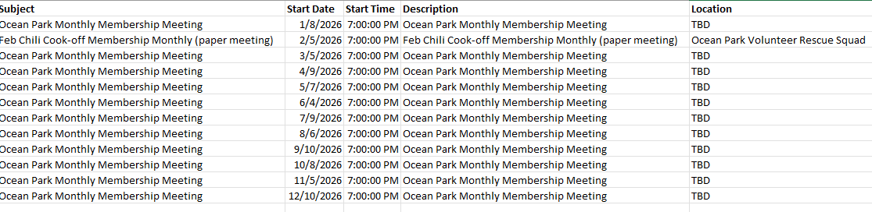
Board of Directors:
President: Danny Murphy
Vice President: Andrea Lindemann
Treasurer: Shane Abell
Secretary: Christy Allen
North Side Rep: Natalie McIntyre
South Side Rep: Brian Snyder
At-large Rep: Jill Doczi
At-large Rep: Kristie Weaver
Parliamentarian: Ashley McLeod
GENERAL MEMBERSHIP MEETING
December 4th, 2025 at 7p

Slide 2
Board of Directors:
President: Danny Murphy
Vice President: Andrea Lindemann
Treasurer: Shane Abell
Secretary: Christy Allen
North Side Rep: Natalie McIntyre
South Side Rep: Brian Snyder
At-large Rep: Jill Doczi
At-large Rep: Kristie Weaver
Parliamentarian: Ashley McLeod
GENERAL MEMBERSHIP MEETING
December 4th, 2025 at 7p
Call to Order & Pledge of Allegiance
Special Guests:
Review and Ratification of Minutes
Treasurer’s Report
  Presentation 2026 Budget
Old Business
  December Update of Select Topics
  Committee Updates
  Social Committee/Holiday Events
  2026 Fireworks Update
  Government Affairs:
    City & Community Organizations
New Business
  Continued Bylaws Presentation
Adjournment

Slide 3
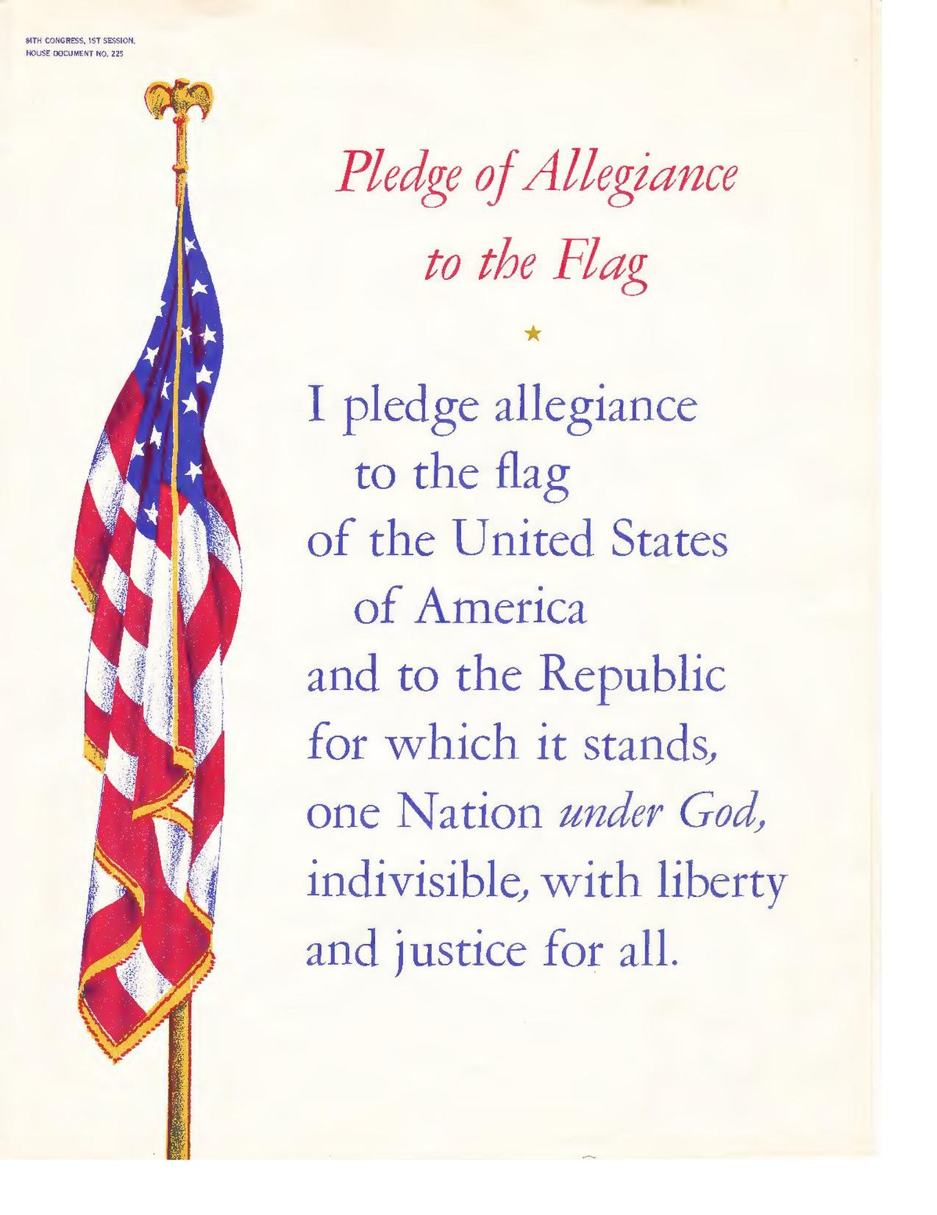

Slide 4
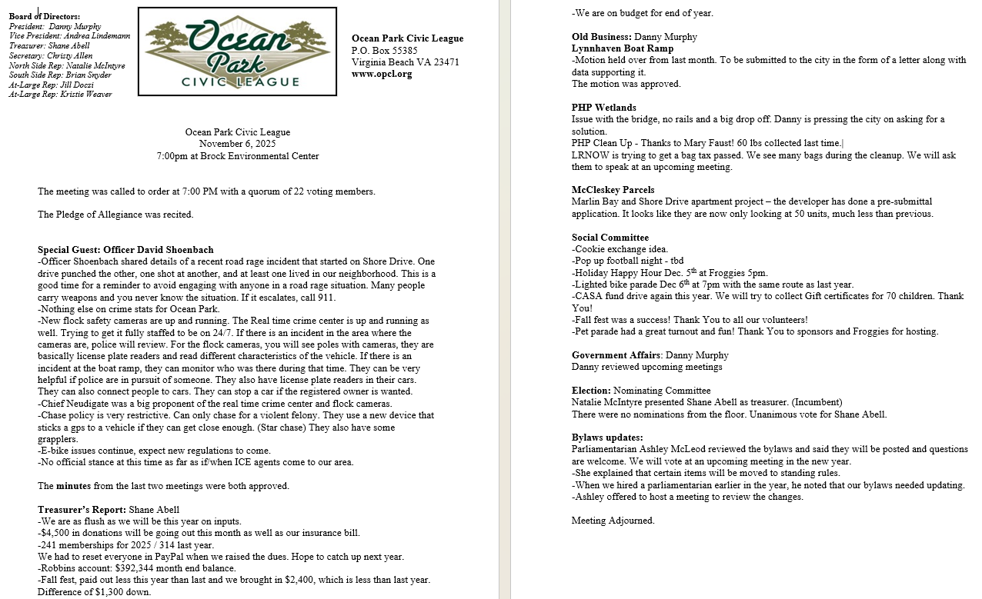
Ratification of Minutes (motion required)
Posted to OPCL.org Website

Slide 5
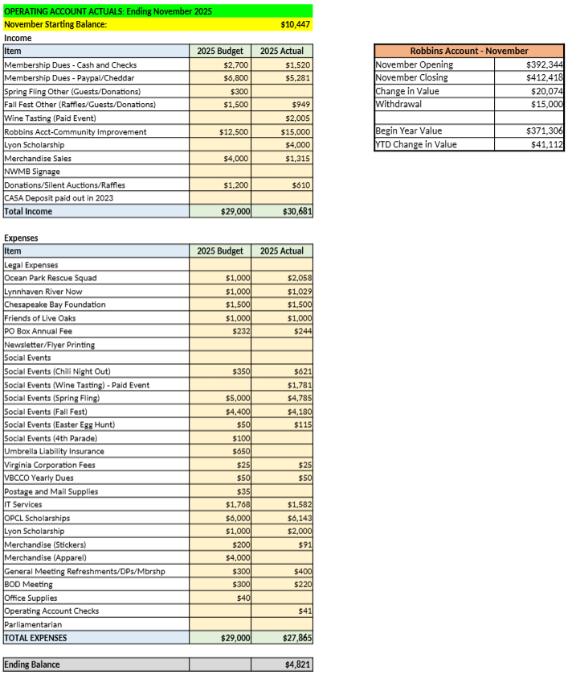
Treasurer's Report: November 2025

Slide 6
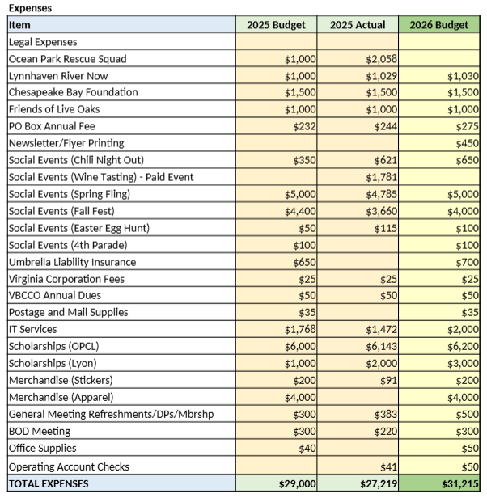
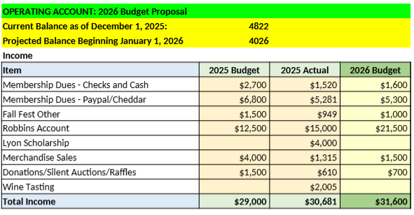
Treasurer's Report: 2026 Budget Presentation

Slide 7
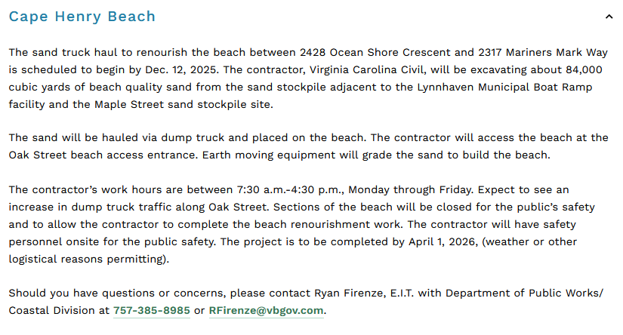
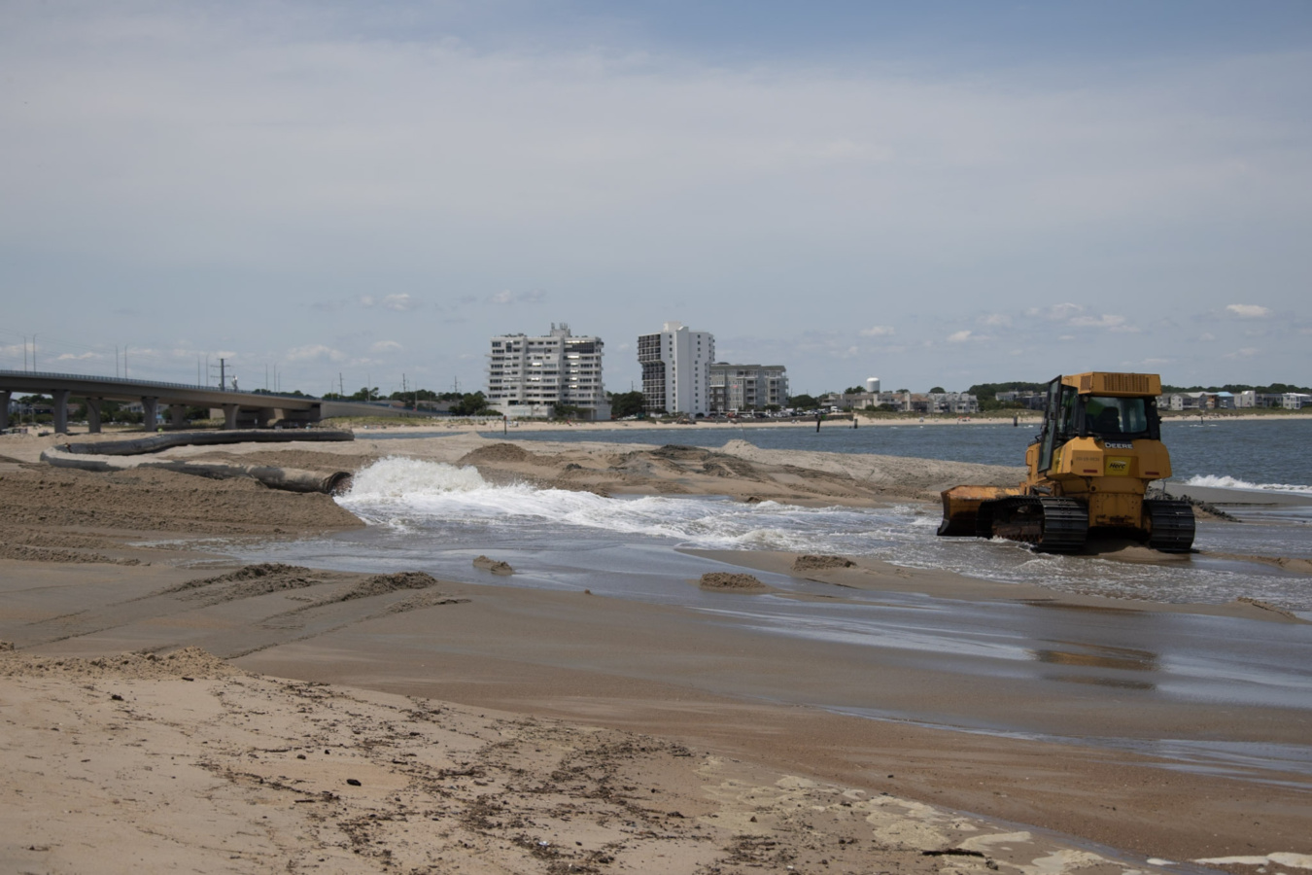
Lynnhaven Boat Ramp- Sand Stock Truck Haul

Slide 8
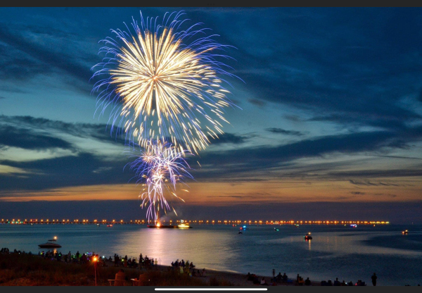
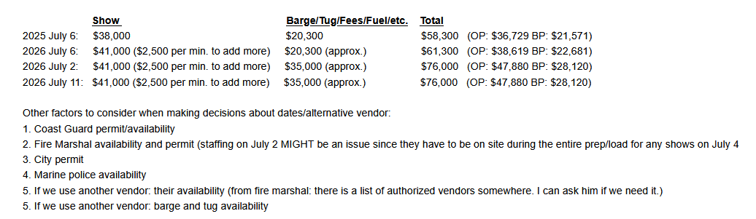
2026 Fireworks Preliminary Discussions

Slide 9


Social Committee: Holiday Events

Slide 10


Social Committee: CASA Fund Drive
Ocean Park continues its tradition of donating gift cards to children in the Virginia Beach CASA program.
CASA recruits, trains, and supports volunteers who advocate for the best interests of these children, with 70 children in the program this year.
This year’s goal is to provide $50 gift cards for each child in the program.
Last year, Ocean Park met its goal by giving cards to all 40 children.
To donate, use the QR code below or follow this link to the donation page in Cheddar Up. You can use your credit card for a secure transaction. We will use the funds to purchase the gift cards for the children.
Buy gift cards ($25 or $50 please) from Target, Walmart, Mastercard/Visa, Amazon, McDonald’s and/or Chick-Fil-A and bring them to the December 4th OPCL meeting at OPVRS, Holiday Happy Hour at Froggies on Dec. 5 . Or contact communication@opcl.org.
Deadline is Dec. 9th. We must give the gift cards to CASA by Dec. 10 so they can distribute them to the children.

Slide 11


Social Committee: OPVRS

Slide 12



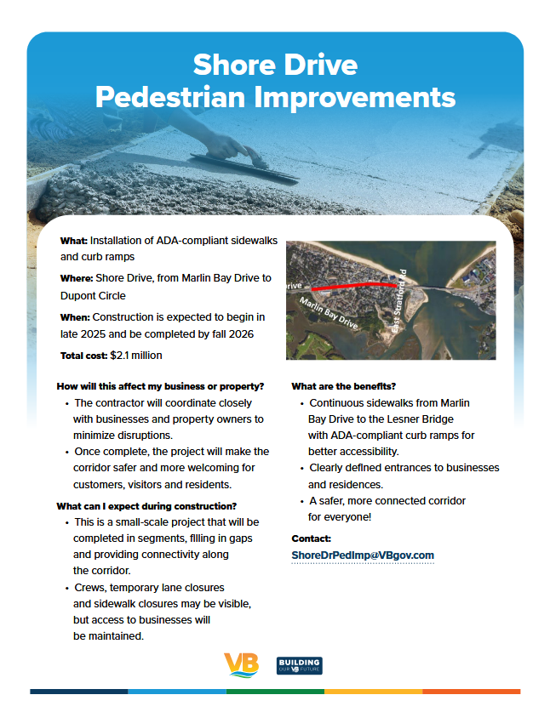
Government Affairs: Upcoming Meetings
VB Council of Community Organizations (VBCCO) meeting: Wednesday, December 17, 2025 General Meeting & Special Meeting (Combined), 6:30p @ Bow Creek Recreation Center
Friends of the Live Oaks (FOLO Meeting) Meeting: December??, 4:00 pm, Brock Environmental Center.
Bayfront Advisory Commission (BAC), No December Meeting
Ocean Park Interim Sidewalk Project – November…. waiting!
Phase 3 Shore Drive Improvements (EAST of Lesner Bridge)
  Loving it!

Slide 13

New Business: Bylaw Updates
✍️ We're proposing updates to the civic league's Bylaws to ensure they reflect our current operational needs and best practices.
Clarity and Modernization: Clarify ambiguous language and remove outdated provisions, making the Bylaws easier for members to understand and follow.
Operational Efficiency: Streamline our election process and meeting procedures, allowing the board to operate more efficiently.
Enhanced Member Participation changes by encouraging broader member involvement by clarifying voting procedures.
Member feedback will be incorporated into a final version for membership review a month prior to any formal vote. Bylaws require 2/3 of the membership to approve.

Slide 14

Adjournment.

Slide 15

Member Forum!
  Volunteers needed: Specifically Social Committee and Membership Chairpersons & Committee Members

