Slide 1
Robbins’ Account
Managed By Wells Fargo Advisors

Slide 2
Agenda
Account Types
Brokerage History
Historical Returns Chart
Updated Brokerage Strategy
Pacific Life Frontier Annuity

Slide 3
Account Types
Brokerage
  Main Account
Business Brokerage
  Pacific Frontier Annuity

Slide 4
Brokerage History
Fund Inception - 2008
Beginning Market Value - $181,538
Initial Asset Types – Cash, Fixed Income Securities (Corporate and Municipal Bonds), and Annuity
Returns
  15 Positive – From .36% to 15.78%
  3 Negative – From -2.43% to -15.59%
  Total since Inception - 5.66%*
Total Investment Results - $268,811*
Total Withdrawals - $49,176
* As of 7 January 2026

Slide 5
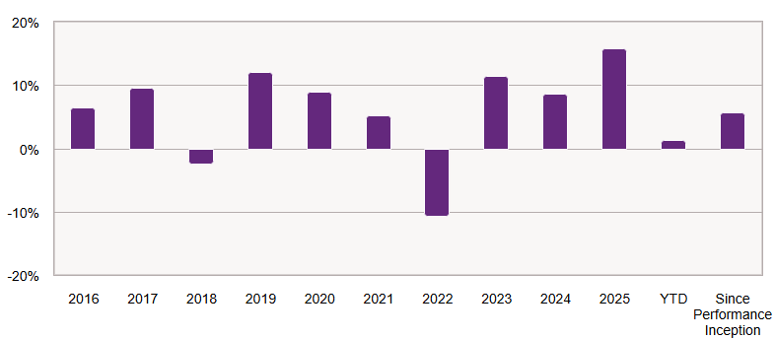
Historical Returns Chart

Slide 6
Updated Brokerage Strategy
Initiated – December, 2024
Invest in the 15 Highest Dividend Earning Stocks
Rotate Funds as Dividends Change
2025 Dividends - $13,291
2025 Gains - $26,071
2025 Withdrawal - $15,000
2026 Estimated Dividends - $14,251

Slide 7
Pacific Life Frontier Annuity
Tracked Separately Beginning December, 2024
$10,000 Annuity
Beginning Market Value – $15,283 (After Separating from Brokerage)
2025 Ending Market Value - $15,458 (3% Return)

