Slide 1

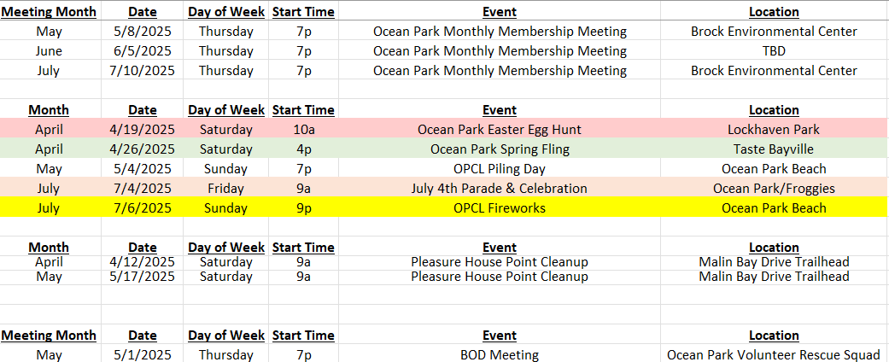

Slide 2
GENERAL MEMBERSHIP MEETING
Mar. 7th, 2025 at 7p
Board of Directors:
President: Danny Murphy
Vice President: Andrea Lindemann
Treasurer: Shane Abell
Secretary: Christy Allen
North Side Rep: Natalie McIntyre
South Side Rep: Brian Snyder
At-large Rep: Jill Doczi
At-large Rep: Kristie Weaver
Call to Order & Pledge of Allegiance
Special Guests
  VBPD, VB Parks & Rec & (maybe) Councilman Schulman
Review and Ratification of Minutes
Treasurer’s Report
Old Business
  Committee Updates
  Social Committee Updates –Events
    Recap Wine Tasting-
    April: Easter Egg Hunt 19th
    Spring Fling 26th
  Fireworks Update
  SUNDAY JULY 6th 9pm
  Government Affairs:
    Pleasure House Point Wetland Mitigation Bank Project
    City & Community Organizations
      Project Updates
    Community Art
      OPVRS Mural Project
      LOVE Sign
New Business
  Call for Volunteers
Adjournment

Slide 3
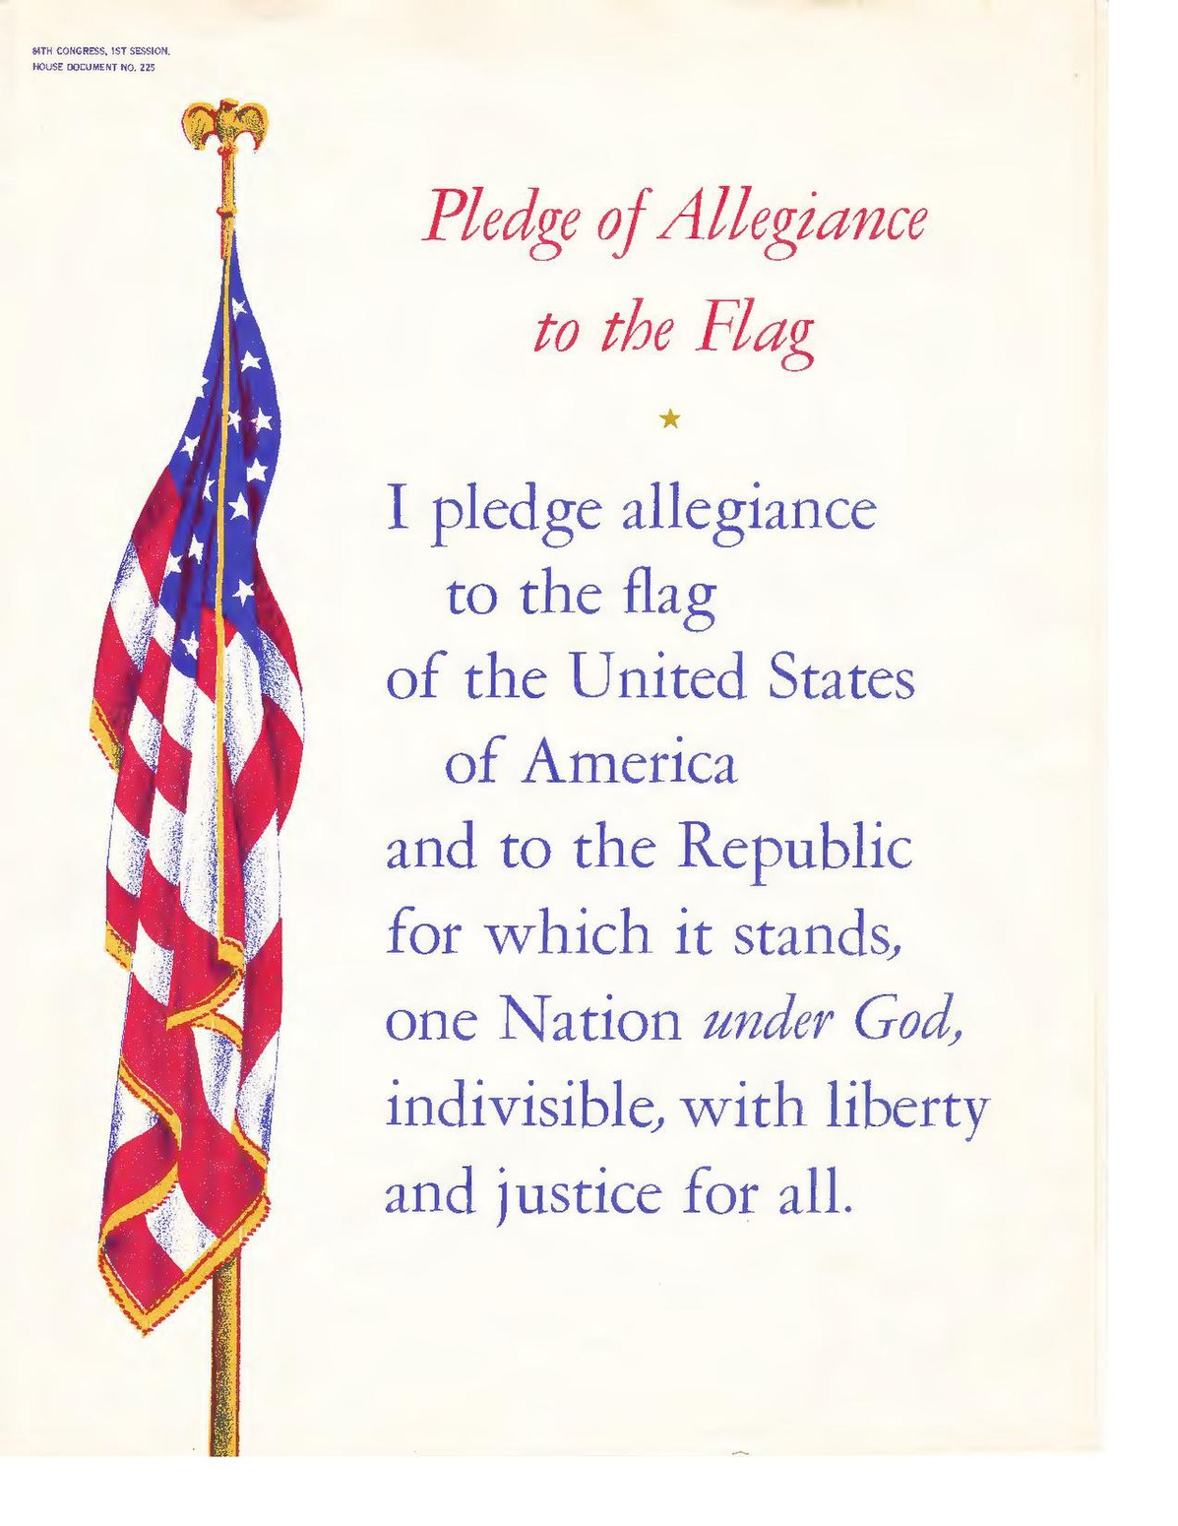

Slide 4

Guests
Virginia Beach Police Department
Capt. James Gordon,3rd Precinct Commanding Officer, Officer
Shoenbach, Community Relations Officer
VB Parks & Recreation Department
Michael Kirschman, Parks & Recreation Director
Michael Parkman, Operations Manager
Amanda Parrish, Programs and Special Use Coordinator
  City Council
  (tentative) Councilman Schulman

Slide 5
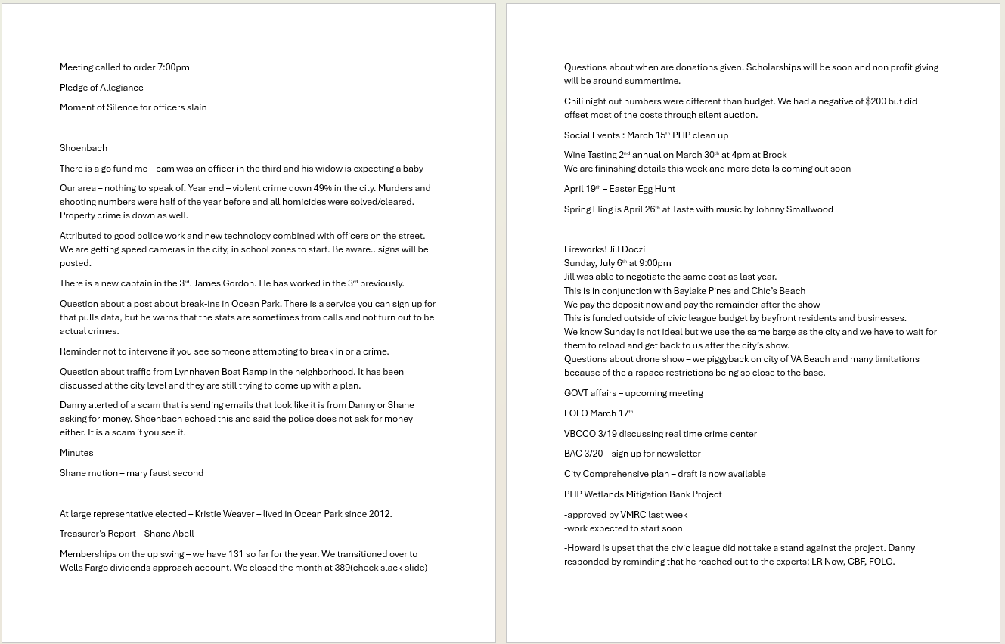
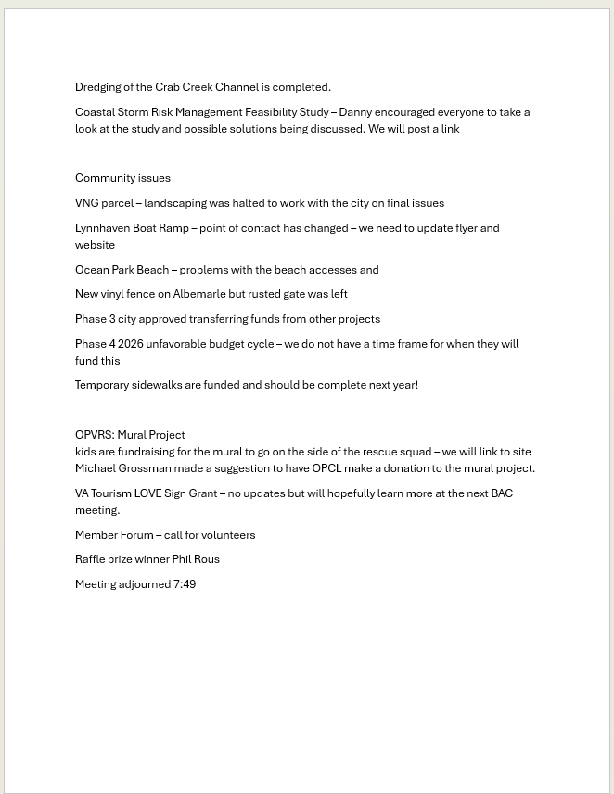
Ratification of Minutes (motion required)
Posted to OPCL.org Website

Slide 6
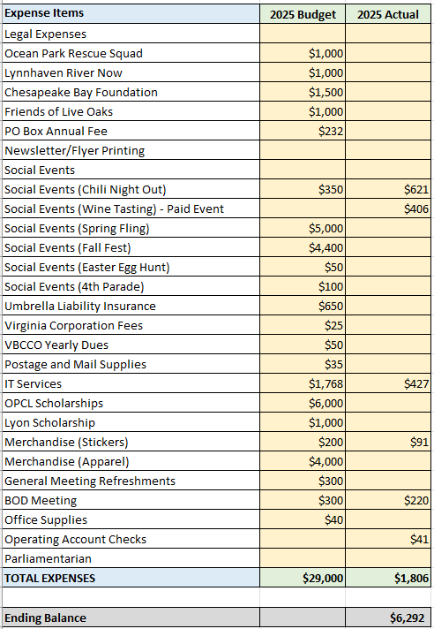
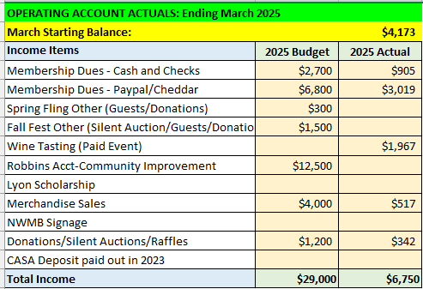
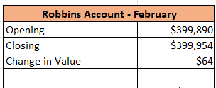
Treasurer's Report: Apr 2025

Slide 7
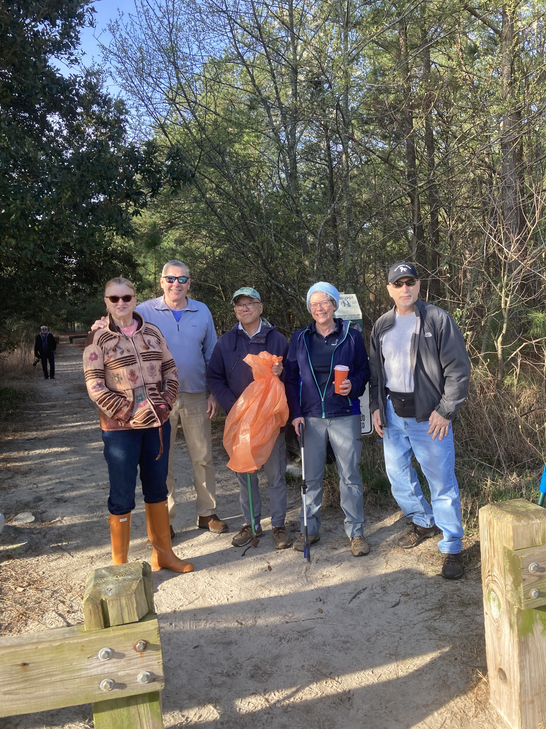
Events: April
Pleasure House Point Cleanup
Saturday, Apr 12th
Time: 9 am
Location: Marlin Bay Drive Trailhead

Slide 8
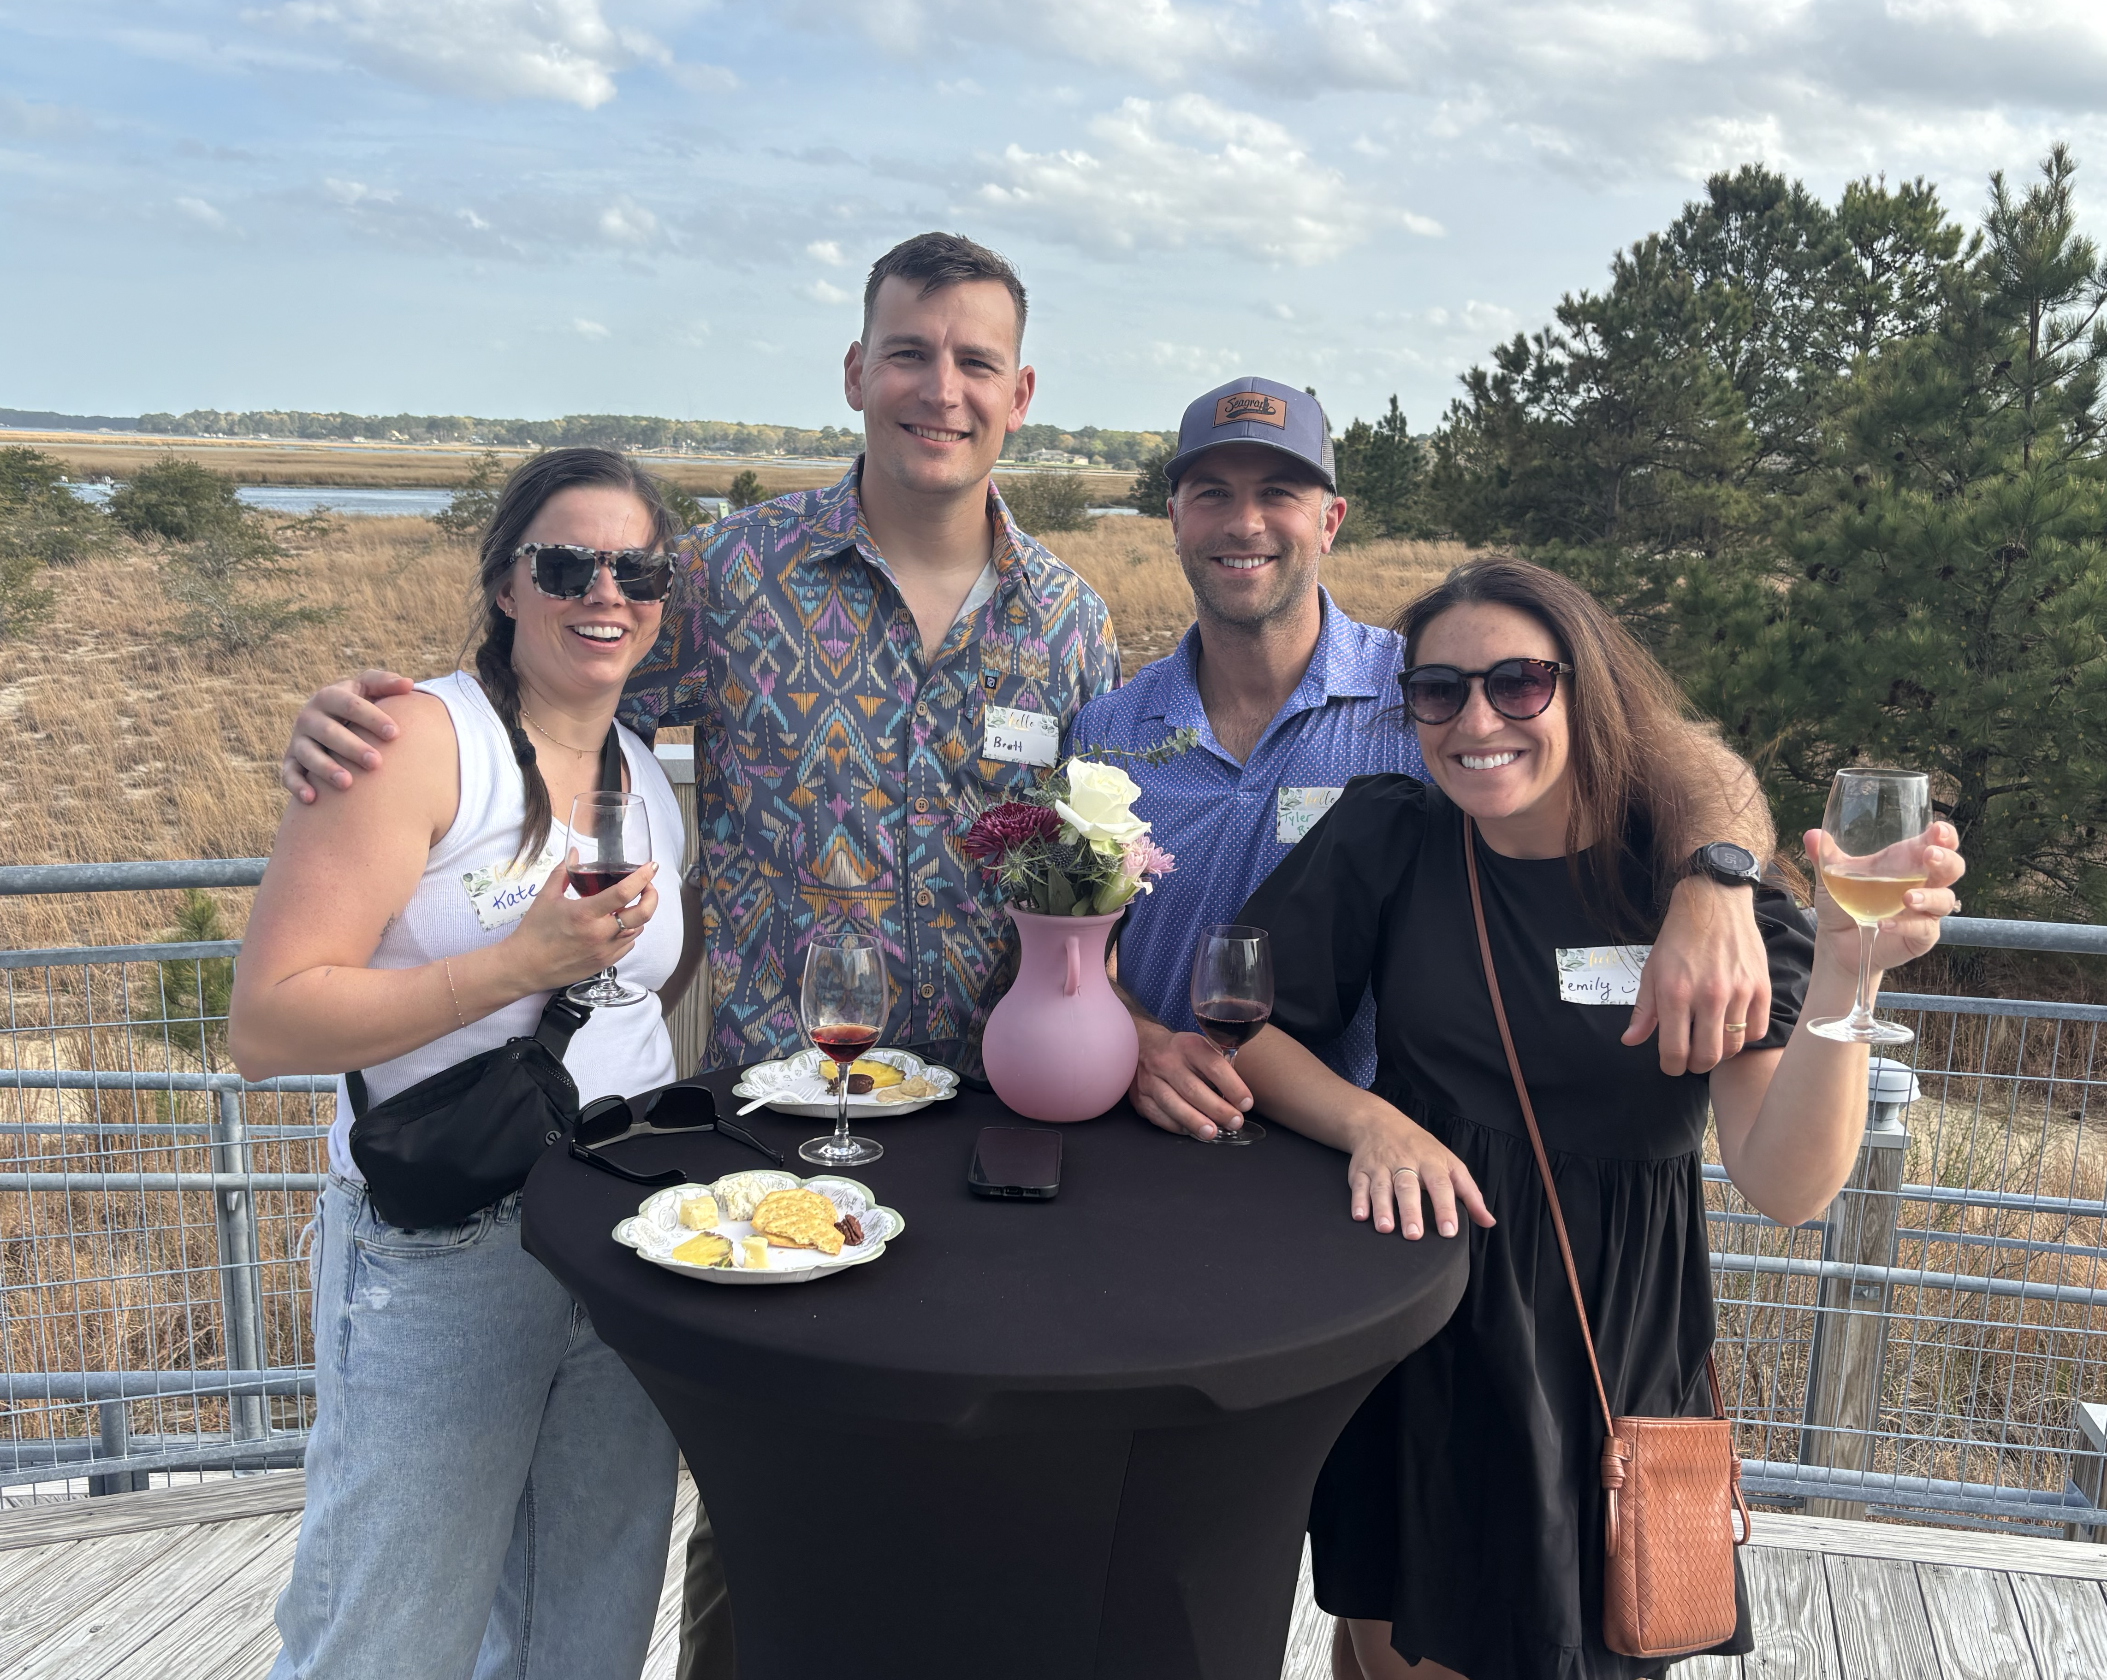
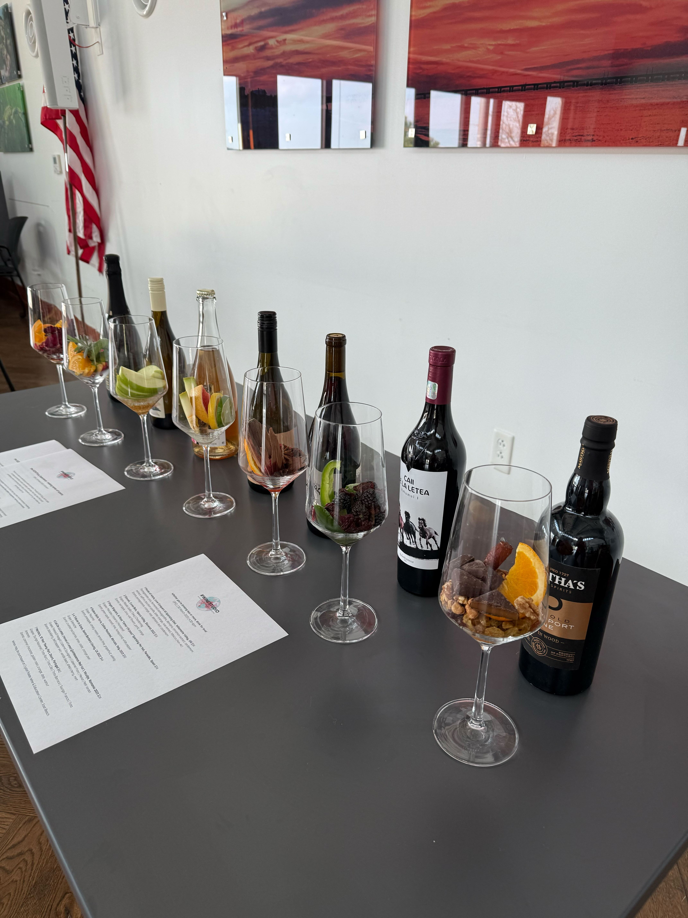

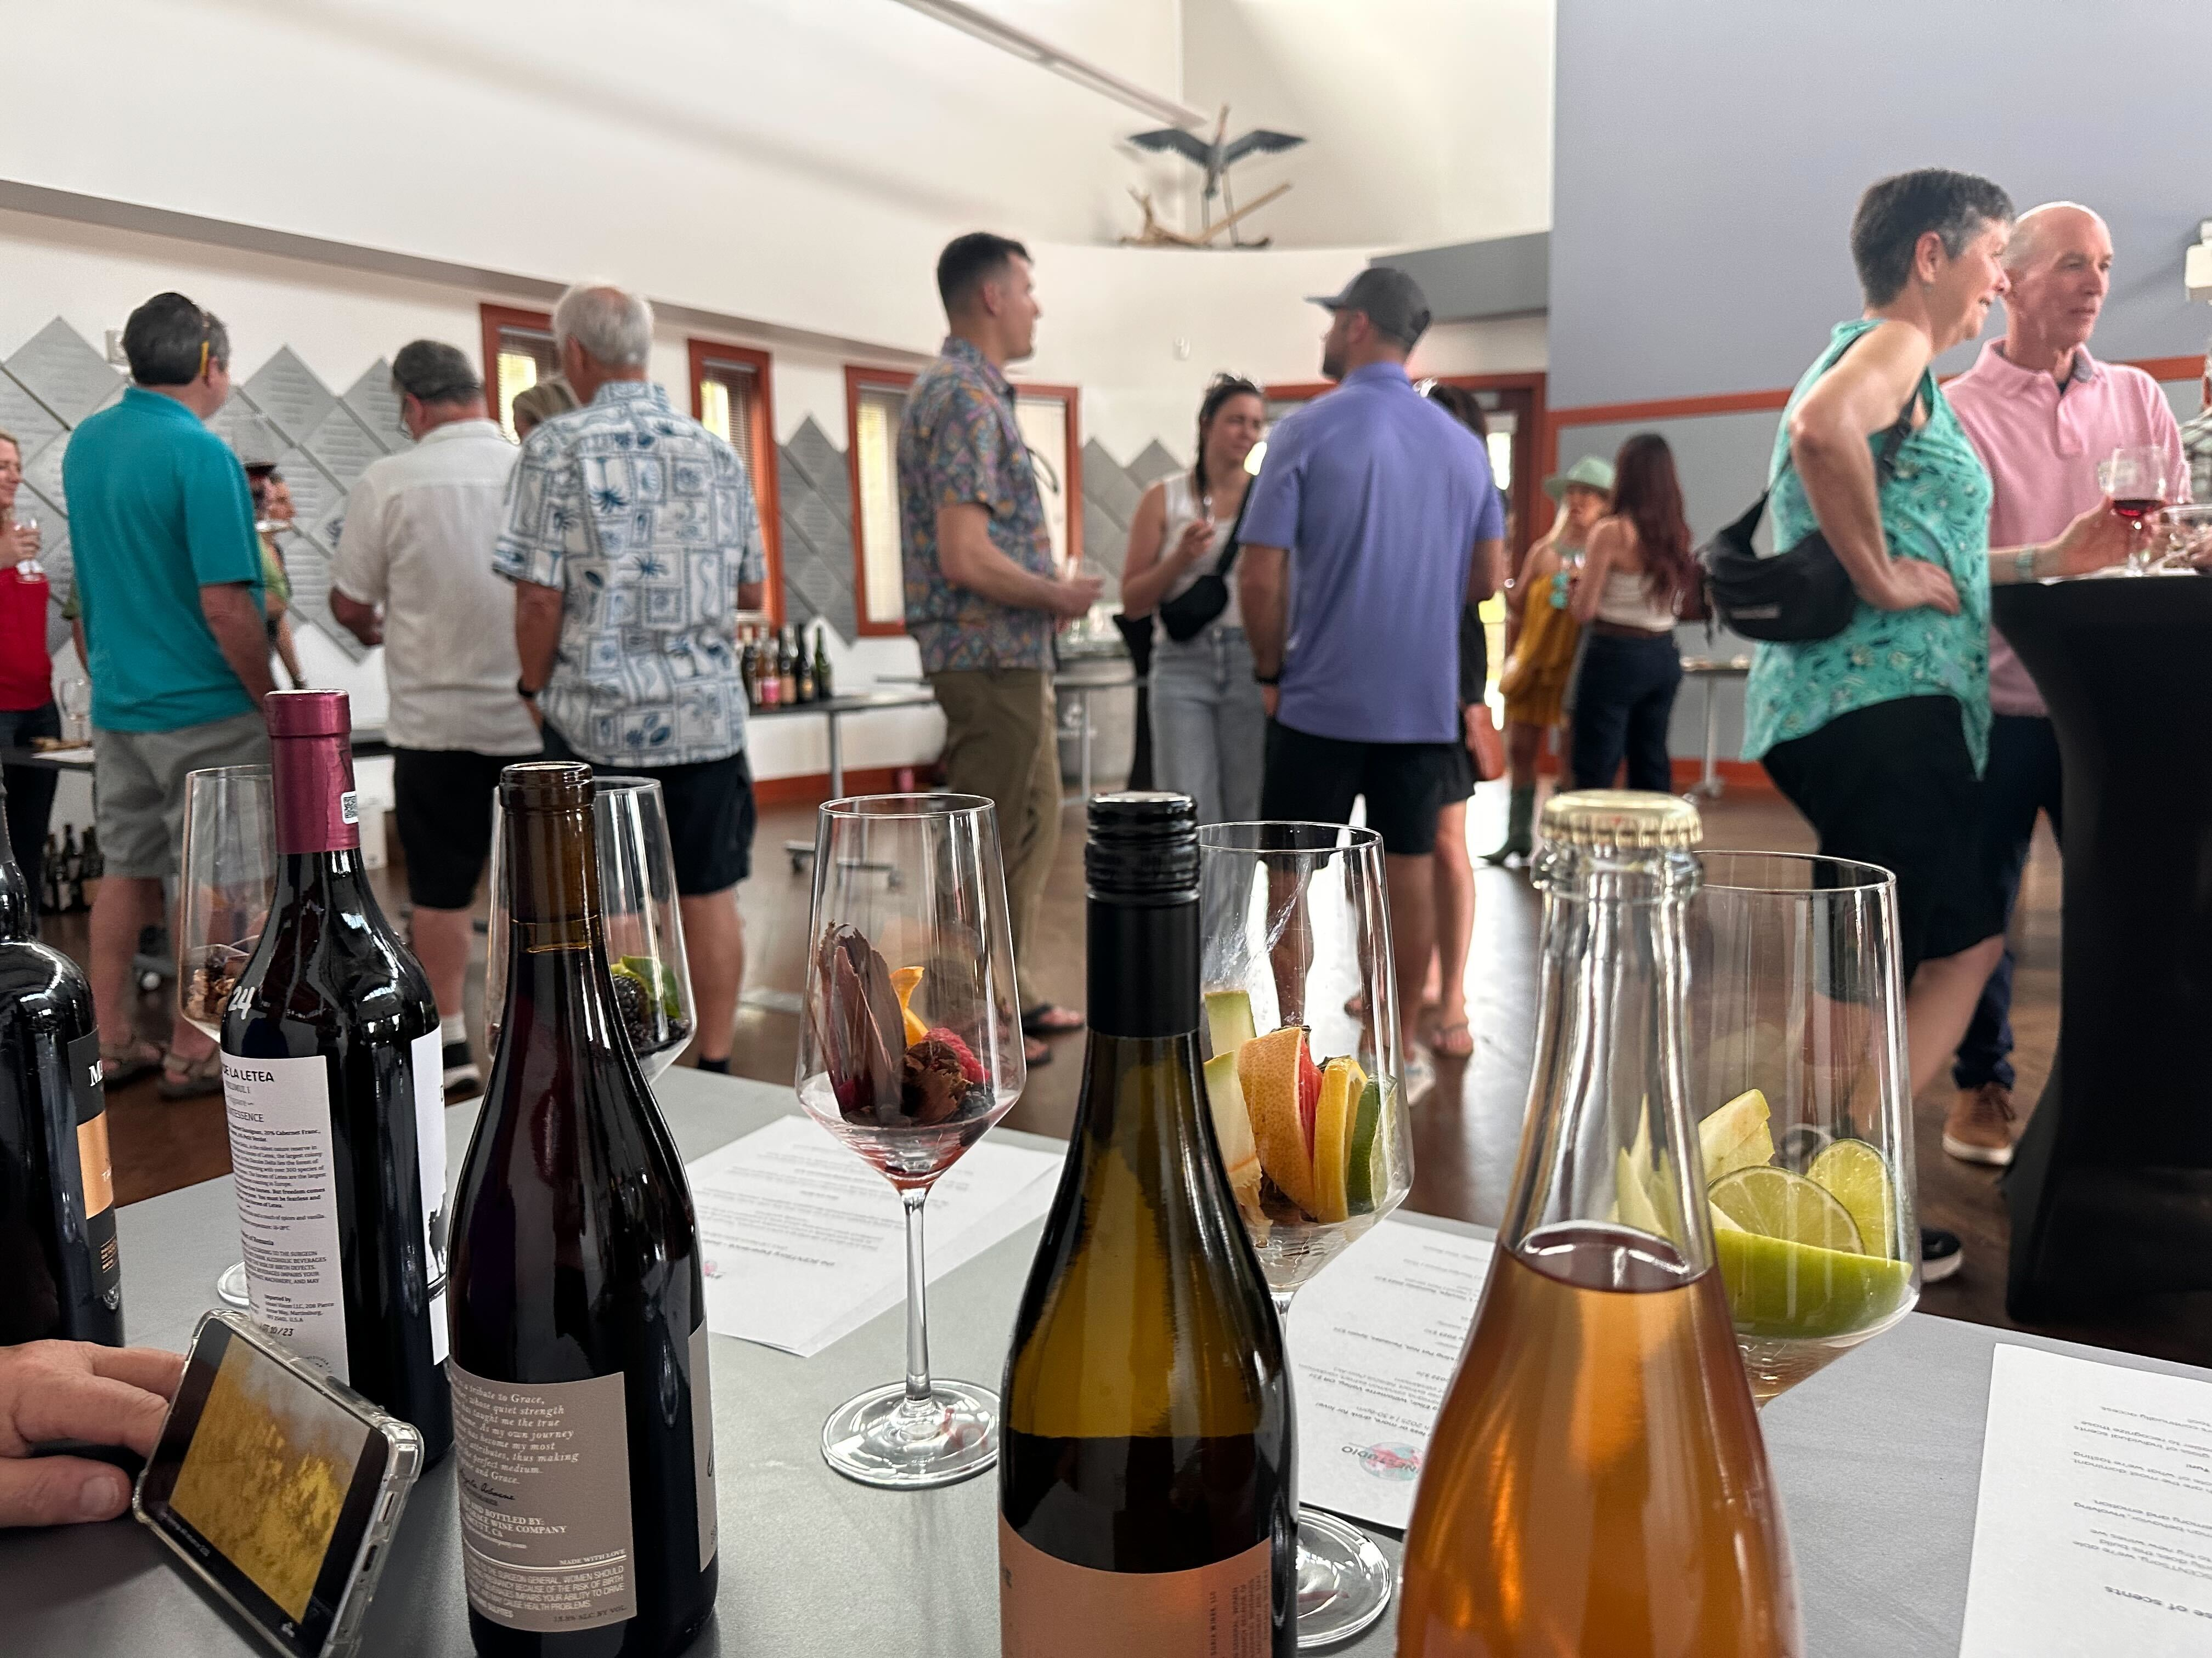
Social Committee: Wine Tastng Recap
Wine Tasting 2nd Annual

Slide 9
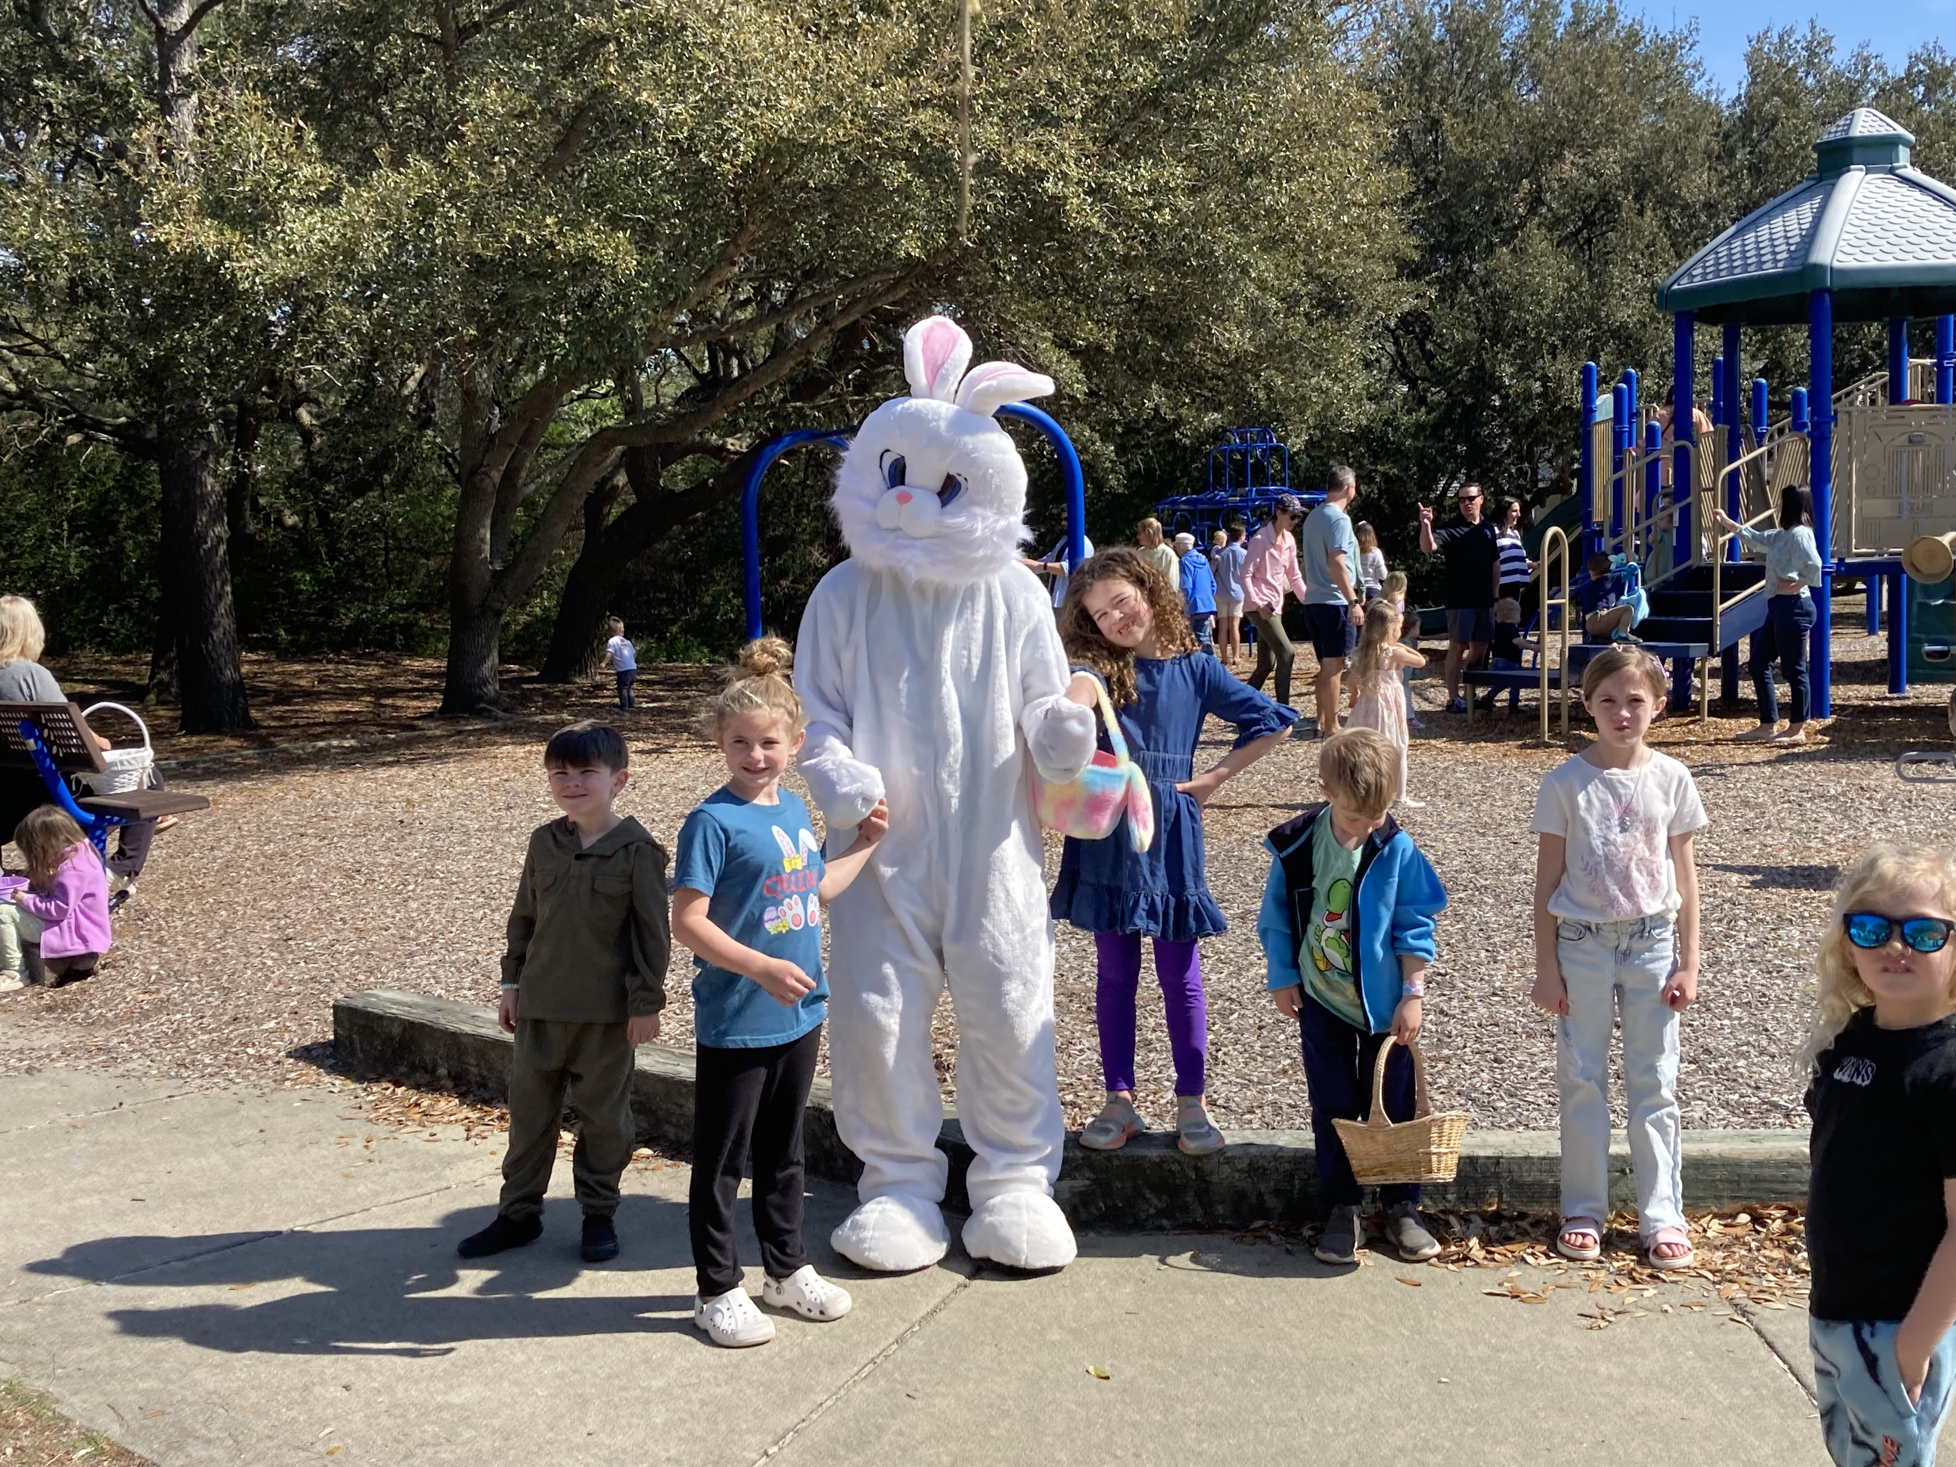
Social Committee: Easter Egg Hunt
Easter Egg Hunt
Saturday, Apr 19th
Time: 10 am
Location: Lock Haven Park
Entertainment: Shane the Bunny!

Slide 10
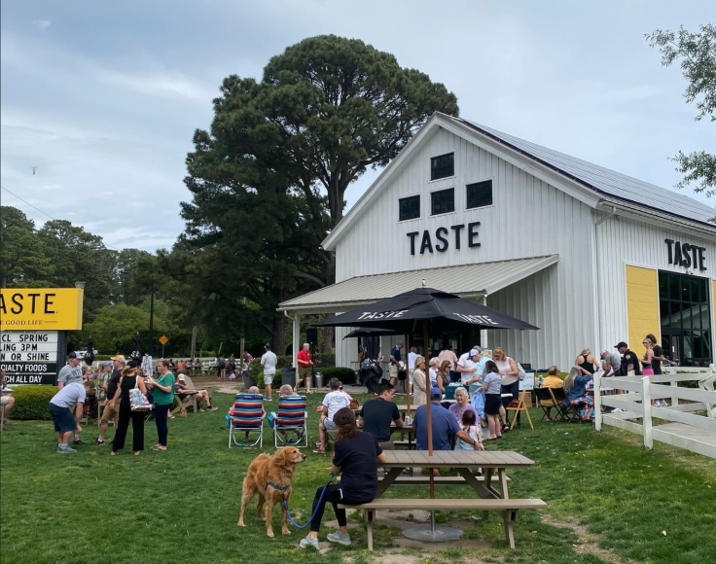

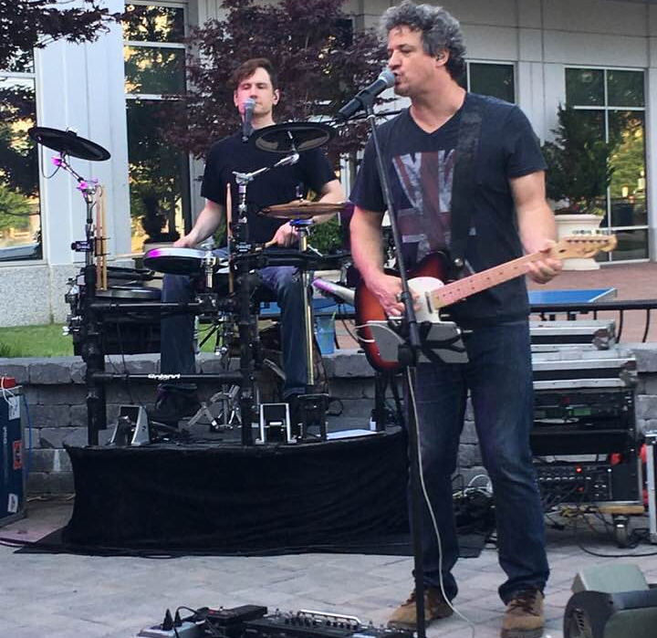
Social Committee: Spring Fling
Spring Fling
Saturday, Apr 26th
Time: 4 pm
Location: Taste Bayville
Music: Johnny Smallwood

Slide 11
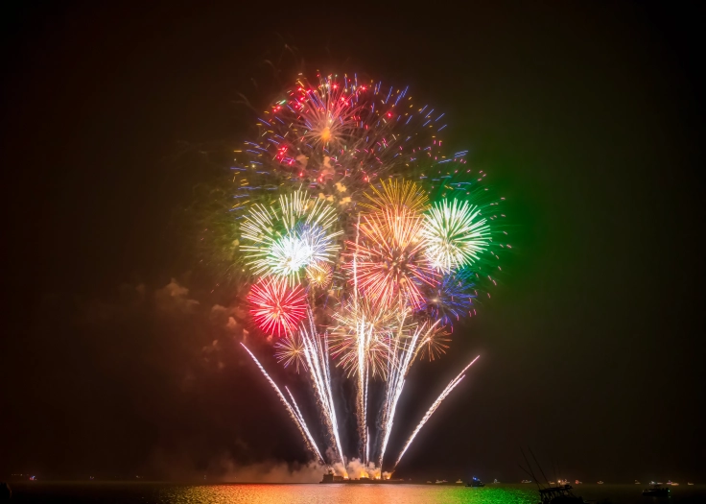
2025 Fireworks!
Date: Sunday, July 6th
Time: 9 pm
Location: Ocean Park Beach
Negotiated 2-year cost (last year)
In conjunction with Bay Lake Pine & Chix Beach
Funded outside of Civic League Budget by Bayfront constituents

Slide 12
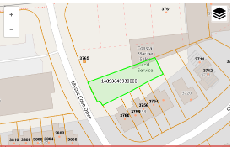
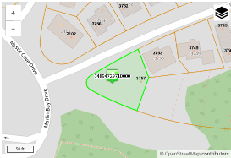
Old Business: McLeskey Parcels
Development of 2 Lots
2208 (?) Mystic Cove Drive (behind OPVRS)
3757 Chesterfield Ave
By Right Zoning
Duplex buildings
Mystic Cove 1-2 months & Chesterfield 2-4 months

Slide 13
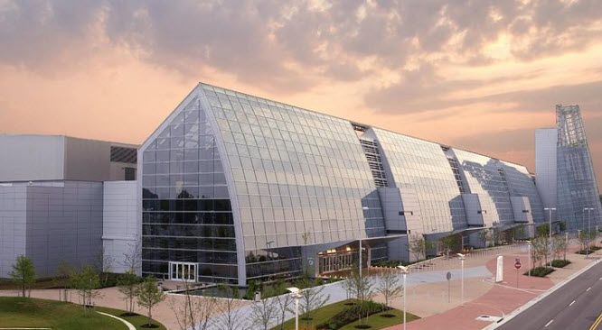

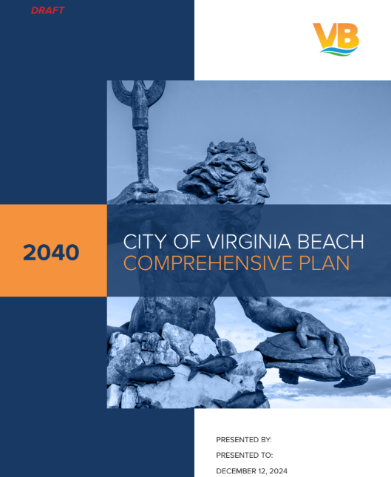
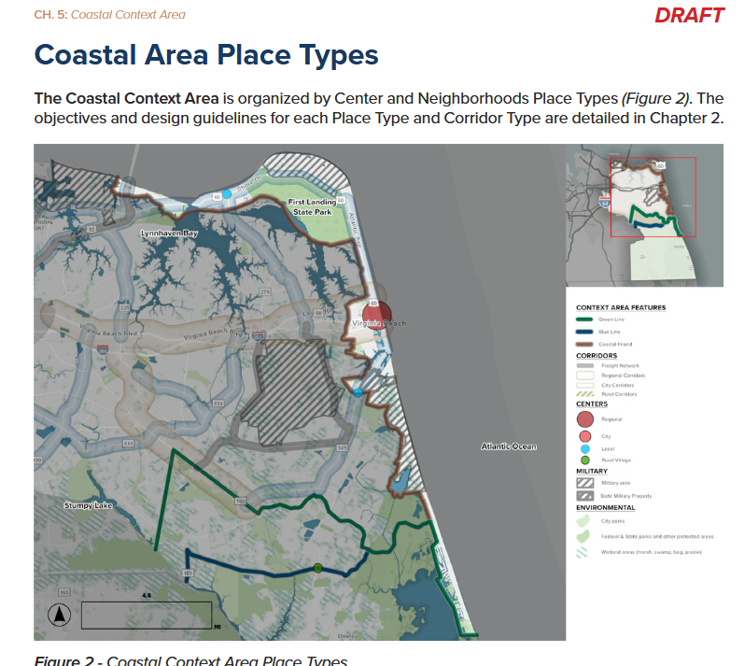



Government Affairs: Upcoming Meetings
VB Council of Community Organizations Next meeting: Wednesday, April 16th @ 6:30 pm, Bow Creek Rec Center, Representatives from the Virginia Beach Rescue Foundation.
Bayfront Advisory Commission (BAC), Thursday, Mar. 20th @ 3:30 pm OPVRS Ocean Park Rescue Squad, Signup for Baylines (BAC Email)
CoVB Comprehensive Plan – Draft
  Available on-line https://planning.virginiabeach.gov/comp-plan/2040-comprehensive-plan-draft-document
Shore Drive Interim Sidewalks- Still on target to begin 2025 Q4 with completion 2026 Q2

Slide 14
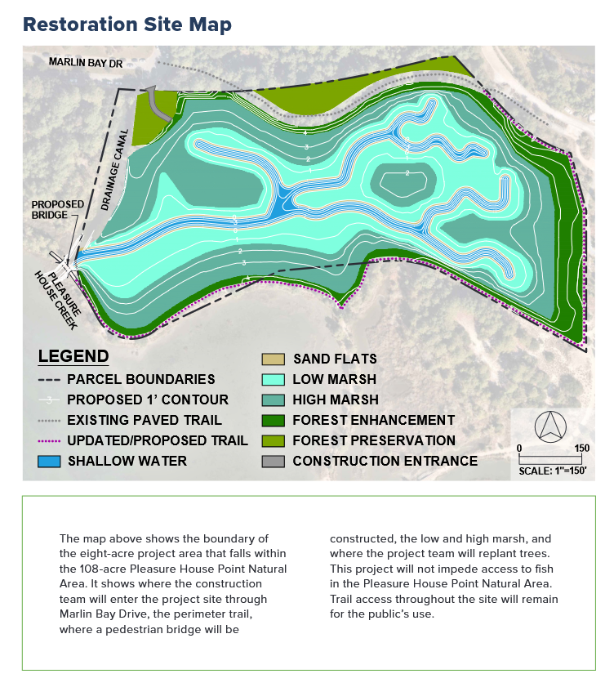
Government Affairs: PHP Wetlands Mitigation Bank Project
Overview
Pleasure House Point Wetlands Restoration Project aims to restore 12.32 acres back to natural tidal wetlands as a mitigation bank (6.22 acres) for VB Flood Mitigation Projects
Project Schedule Updates
April 2025 - June 2025: Wetlands Bank Construction
Installing the turtle guard, temporary educational signs, tree removal and site clearing & grubbing.
Modify land elevation to support wetland development with future sea level rise considerations. These land modifications will not cause neighborhood flooding.
Create a shallow marsh area designed for water detention and filtration.
Establish a network of small tributaries to enhance water flow and habitat diversity, in turn, increasing terrapin turtle accessibility.

Slide 15
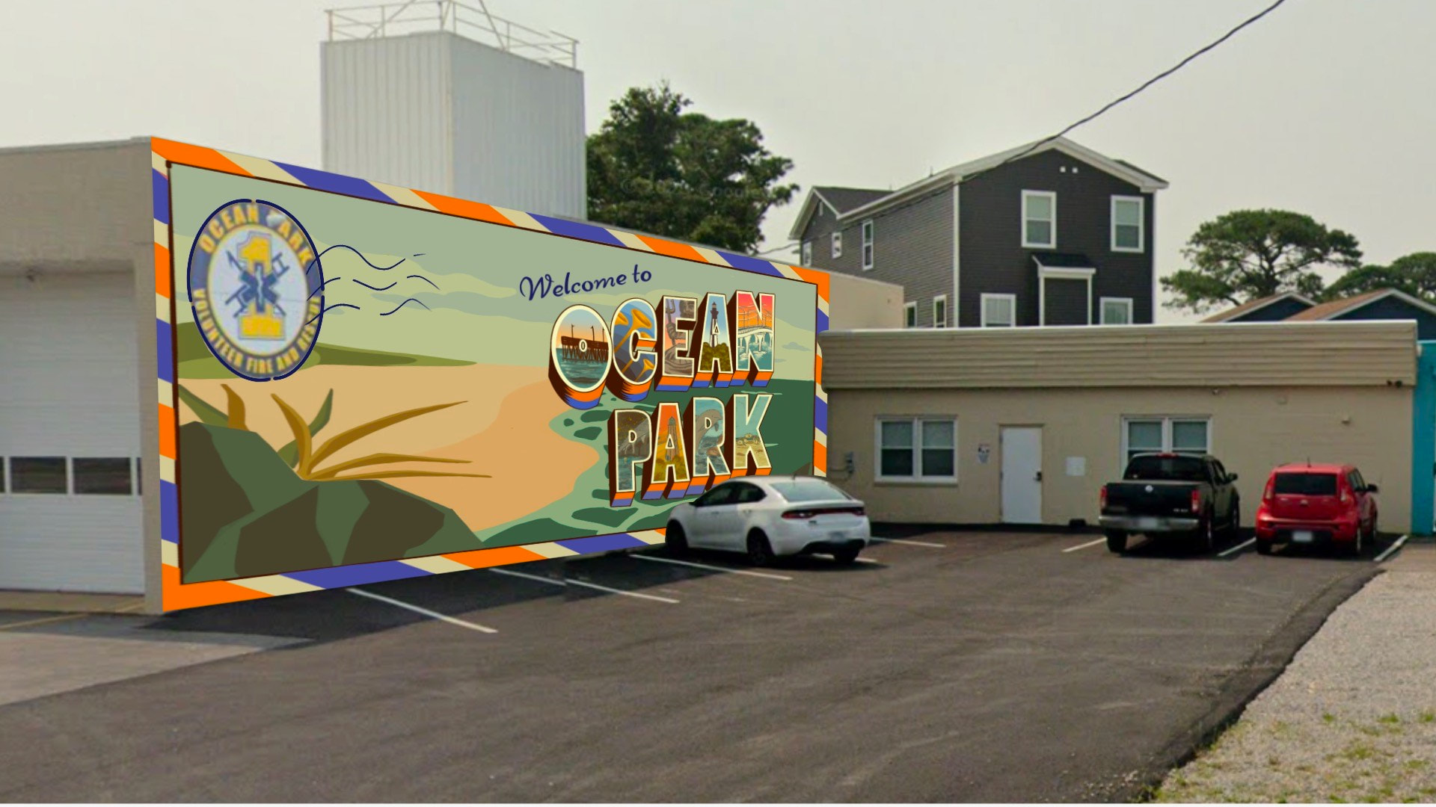

Ocean Park Volunteer Rescue Squad: Mural Project
Mission- This two-story mural will celebrate the Virginia Beach bayfront community and pay tribute to the long-serving rescue squad.
Fundraising Goal: Raise $10,000 to cover the costs of supplies, materials, and artist compensation.
Project Timeline: Apr-Sept 2025
  April to June- Focus on fundraising and promoting the project
  June- Finalize designs
  July- Begin initial preparations and priming
  August- Start the painting process
  September- Unveil the mural and celebrate
Collaboration- Princess Anne High School students are teaming up with the Ocean Park Rescue Squad to create a vibrant community art mural. Additionally, Summer Paradiso, a talented artist, will generously donate her skills and guide the mural creation process.

Slide 16
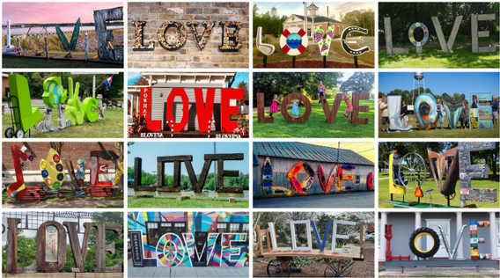
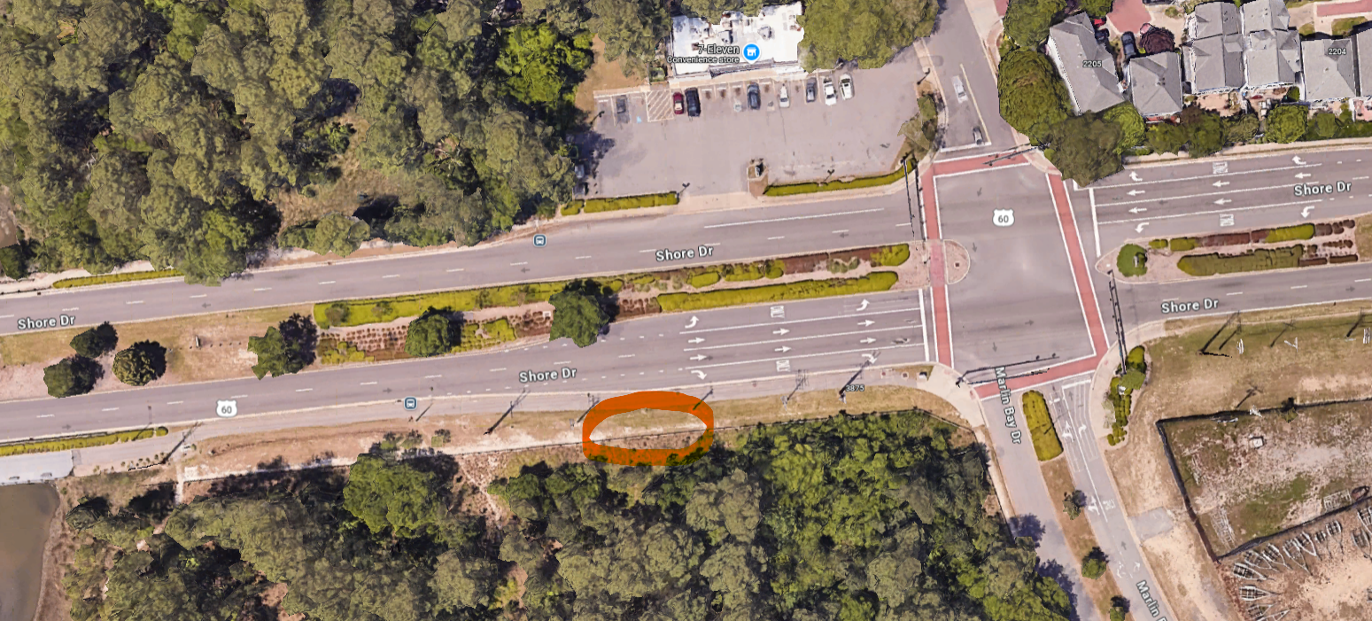
Government Affairs: Bayfront Advisory Commission LOVE Sign
Virginia Tourism Love Sign Grant
Partnered with Bayfront Advisory Commission to bring LOVE to Shore Drive
Initiated in 2020
Granted $1,500
Civic League – Facilitate the grant disbursement & fundraising
Student-led initiative Artist:
  Materials & cost estimates in the process
  Seth Lubaton (Lubaton Murals)
  Design & art drawing coming soon

Slide 17

Member Forum!
  Volunteers needed: Specifically Social Committee and Membership Chairpersons & Committee Members

Slide 18

Adjournment.

